Slide 1
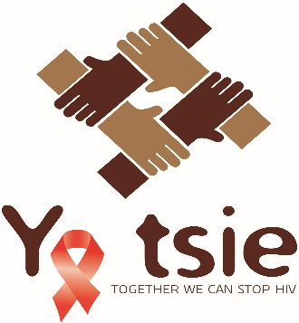
Impact of prevention and treatment interventions on population HIV incidence: Primary results of Botswana Combination Prevention Project (BCPP / Ya Tsie)
M.J. Makhema, K. Wirth, M. Pretorius Holme, T. Gaolathe, M. Mmalane, E. Kadima, U. Chakalisa, K. Manyake, A. Mbikiwa, S. Simon, R. Letlhogile, K. Mukokomani, E. van Widenfelt, S. Moyo, K. Bennett, J. Leidner, R. Lebelonyane, M.G. Alwano, K. Powis, S. Dryden-Peterson, C. Kgathi, V. Novitsky, J. Moore, P. Bachanas, W. Abrams, L. Block, S. El-Halabi, T. Marukutira, L.A. Mills, H. Bussmann, L. Okui, O. John, R. Shapiro, V. DeGruttola, Q. Lei, R. Wang, E. Tchetgen Tchetgen, M. Essex, S. Lockman
Participating Institutions: Harvard T.H. Chan School of Public Health, Botswana-Harvard AIDS Institute Partnership (BHP), Centers for Disease Control and Prevention (CDC), Botswana Ministry of Health (MOH)
Funded by the U.S. President’s Emergency Plan for AIDS Relief (PEPFAR) and the Office of the Global AIDS Coordinator (OGAC)
Sponsored through the U.S. Centers for Disease Control and Prevention (CDC)

Slide 2

Disclosures
No conflicts of interest
Notes:
Significant reduction in HIV incidence in pairs 13 and 15

Slide 3
BCPP Study Design Overview
  Pair-matched community-randomized trial in 30 communities in Botswana (15 intervention and 15 standard of care)
  Designed to evaluate the impact of a package of HIV prevention and treatment interventions on population-level HIV incidence
  Baseline and annual surveys conducted in adult 16-64 year old residents of random sample of ~20% of households in all 30 communities, to evaluate:
  HIV incidence
  Uptake of components of interventions over time
Rapid scale-up of interventions in intervention communities, immediately following enrollment of HIV incidence cohort at baseline
Study started in October 2013, interventions ended in March 2018, follow-up completed in June 2018
Notes:
Mochudi Project - Gates
8 October 2008
3

Slide 4
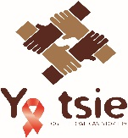
Study Interventions
Interventions in the 15 intervention communities:
  Community mobilization
  Home-based / mobile HIV testing campaigns, targeted testing
  Linkage to care support: scheduled clinic appointment, SMS reminder, active tracing if missed appointment
  Expanded antiretroviral treatment (ART):
    Universal ART as of June 2016 (with treatment started at first clinic visit)
    Previously, expanded ART for residents with CD4 351-500, or with CD4 >500 + HIV-1 RNA≥10,000
  Strengthened male circumcision (MC) services
  Interventions were delivered at government clinics
In the 15 standard of care communities:
  ART for persons with CD4<350, WHO III/IV disease or pregnancy until June 2016, when transitioned to universal ART

Slide 5

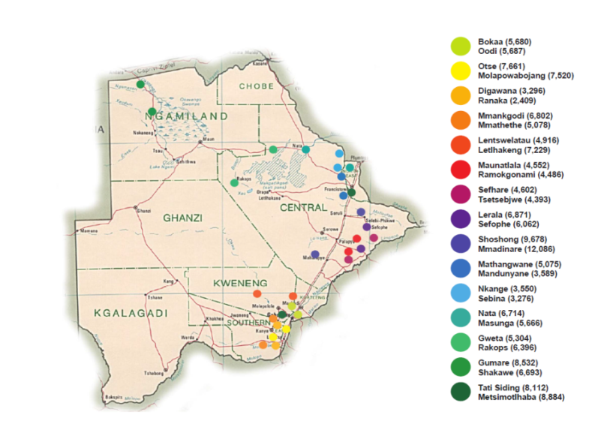
Participating Communities
  Average community population 6,000
  Total population ~180,800 (nearly 10% of entire Botswana population)

Slide 6
HIV Incidence Cohort
Primary endpoint: cumulative HIV incidence over ~30 months (annualized)
HIV incidence determined in prospective HIV Incidence Cohort of HIV-negative residents of random sample of ~20% of households from all 30 communities
15 standard of care
communities
End of study
(ESS)
cross-sectional survey
(100% of 3 pairs)
20% cohort,
(HIV-neg)
20% cohort
20% cohort
Randomized
Within
Pairs
1st follow-up
2nd follow-up (~30mo)
20% cohort
(HIV-neg)
20% cohort
20% cohort
15 intervention
communities
Interventions

Slide 7
Enrollment & Retention of HIV Incidence Cohort Participants by Arm
Standard of Care Arm
Intervention Arm
4,487 Enrolled
4,487 Enrolled
Deceased: 20 (<1%)
Ineligible: 2 (<1%)
Refused retesting: 40(<1%)
Absent/moved: 124 (3%)
Unknown: 11 (<1%)
Deceased: 8 (<1%)
Ineligible: 1 (<1%)
Refused retesting: 63 (1%)
Absent/moved: 151 (3%)
Unknown: 7 (<1%)
Re-tested for HIV at least once:
4,290 (96%)
4,257 (95%)
Notes:
Ineligible participants were either incarcerated or disabled.
Table reflects data updated on 21June2018.

Slide 8
Baseline Socio-demographic and HIV-Related Factors by Arm
Characteristic | Standard of Care Arm | Intervention arm
HIV Incidence Cohort | N=4,487 | N=4,487
Female | 60% | 60%
Age (median years) | 29 | 30
Relationship: single/never married | 80% | 78%
Education: primary or lower | 26% | 24%
No monthly income | 59% | 54%
Baseline HIV-related factors by arm (N=12,610)
HIV prevalence | 28% | 29%
1st 90: % of HIV-positive persons who knew (+)status | 84% | 83%
2nd 90: % of known HIV-positive persons on ART | 87% | 87%
3rd 90: % of persons on ART with HIV-1 RNA<400 cp/mL | 96% | 97%
% of all HIV+ persons with HIV-1 RNA<400 cp/mL | 70% | 70%

Slide 9
Primary Results: HIV Incidence in the Intervention vs. Standard of Care Arms
57 participants in the intervention arm (annualized HIV incidence: 0.59%) and 90 in the standard of care arm (annualized HIV incidence: 0.92%) acquired HIV.
Results of unadjusted and adjusted analyses of treatment effect
Analysis | Incidence Ratio | 95% CI | 2-sided p-value
Primary analysis (permutation test, pair-specific Cox PHM), unadjusted | 0.69 |  | 0.09
Analysis to obtain 95% CI (standard pair-stratified Cox PHM), unadjusted | 0.65 | 0.46-0.90 | 0.01
Primary analysis, adjusted* | 0.62 |  | 0.04
Analysis to obtain 95% CI, adjusted* | 0.70 | 0.50-0.99 | 0.04
* Covariates in adjusted analyses were: sex, age, education, marital status, concurrent sexual partners, and alcohol during last sex
Results of main analyses are consistent, and indicate at least 30% reduction in HIV incidence associated with the intervention
Notes:
Endpoint: cumulative HIV incidence over ~30 months (annualized)
Population (HIV incidence cohort):
HIV-uninfected residents of 20% sample of households in all 30 communities, enrolled at baseline (prior to interventions)
Pre-specified analysis of incidence ratio, treatment effect
Pair-specific Cox proportional hazards model for interval censoring, inverse-variance weighted average of log incidence ratio for every pair
P-value from inverse variance weighted permutation test
Additional analysis to obtain 95% confidence interval (CI)
Cox proportional hazards model for interval censoring stratified by pair
Adjusted analyses used strategy of backward variable selection pooled across intervention arms was used to select covariates for adjusted analysis

Slide 10
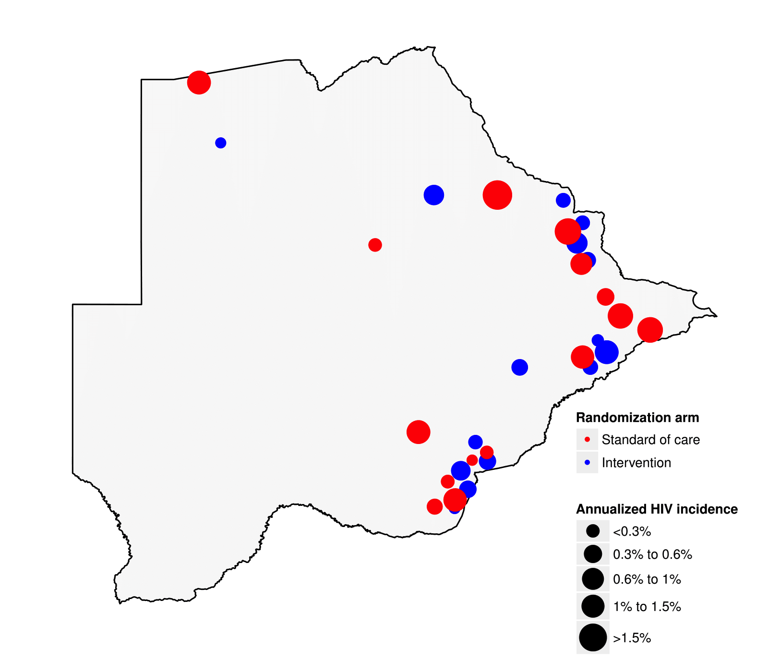
Map of Annualized HIV Incidence by Community
and Randomization Arm
HIV incidence was quite variable by community (range 0.23 – 1.81)

Slide 11
Estimated Survival Curve (95% CI) for Time to HIV Seroconversion by Randomization Arm

Slide 12
Proportions of all HIV+ Persons with Undetectable HIV-1 RNA At Study End (from 6 End of Study communities, 3 pairs)
By end of study, an additional 18% of HIV-positive persons in the intervention arm vs. 7% in the standard of care arm had viral load suppression (p<0.0001)
  Intervention arm: 88% of all persons identified with HIV had undetectable viral load
Uptake of male circumcision was low in both arms

Slide 13
Conclusions
We observed a 30% reduction in community HIV incidence with a combination of community-based HIV testing, linkage-to-care, and ART interventions
It is possible to increase ART coverage and reduce HIV incidence in a high-prevalence generalized epidemic, even when very high baseline ART coverage exists

Slide 14
Acknowledgements
BCPP Participants BCPP Study Team HSPH Molly Pretorius Holme Max Essex Shahin Lockman Kathleen Wirth Eric J. Tchetgen Tchetgen Kara Bennett Jean Leidner Kathleen Powis Vlad Novitsky Scott Dryden-Peterson Victor DeGruttola Quanhong Lei Rui Wang Hermann Bussmann Roger Shapiro | BHP Joseph Makhema Mompati Mmalane Tendani Gaolathe Etienne Kadima Unoda Chakalisa Sikhulile Moyo Mosepele Mosepele Kutlo Manyake Coulson Kgathi Erik van Widenfelt Atang Mbikiwa Rona Letlhogile S. Vinoliah Simon Oaitse John Kutlwano Mukokomani Lillian Okui Ria Madison | CDC Janet Moore Pamela Bachanas Lisa Block William Abrams Tafireyi Marukutira Lisa A. Mills Mary Grace Alwano Michelle Roland Connie Sexton Joseph Jarvis MOH Refeletswe Lebelonyane Shenaaz el-Halabi
Funded by the U.S. President’s Emergency Plan for AIDS Relief (PEPFAR) and the Office of the Global AIDS Coordinator (OGAC)
Participating Institutions: Harvard T.H. Chan School of Public Health, Botswana-Harvard AIDS Institute Partnership (BHP), Centers for Disease Control and Prevention (CDC), Botswana Ministry of Health (MOH)
Sponsored through the U.S. Centers for Disease Control and Prevention (CDC)

Slide 15
Extra Slides

Slide 16
Intervention Coverage by Randomization Arm
(from 6 End of Study communities, 3 pairs)
HTC
ART in all HIV+
VL<400 in all HIV+
By end of study, an additional 18% of HIV-positive persons in the intervention arm vs 7% in the standard of care arm had viral load suppression (p<0.0001)
  Intervention arm: 88% of all persons identified with HIV had undetectable viral load
Uptake of male circumcision was low in both arms

Slide 17
Intervention Coverage by Randomization Arm
(ART coverage and VL suppression from 20% cohort, all 30 communities)
HTC
ART in all HIV+
VL<400 in all HIV+
Significantly greater increases in HTC, ART and VL suppression coverage in intervention compared with control arm in analyses adjusted for baseline imbalances (P<0.0001 for HTC and ART, P<0.001 for VL)
Pre-specified HTC analysis: the increase in the % of persons who had either tested for HIV in prior 12 months or who knew their HIV+ status was significantly greater in intervention arm (RR 1.29, 95% CI 1.17, 1.43)

Slide 18
Estimated Proportion of all HIV+ Persons with Undetectable HIV-1 RNA At Study End, by Data Source (Overall 90-90-90 Cascade)
95-95-95 coverage = 86% of all HIV+ persons have undetectable HIV-1 RNA
Achieved (exceeded) overall 95-95-95 coverage target in BCPP, according to evaluation data

Slide 19
Estimated Proportion of all HIV+ Persons with Undetectable HIV-1 RNA At Study End, in 6 End of Study Survey Communities
(Overall 90-90-90 Cascade)
An additional 18% of HIV+ persons had VL suppression at study end (compared with baseline) in intervention arm, vs. 7% in control arm (RR 1.14, 95% CI 1.11, 1.16, p<0.0001)
  37% (18/70) vs. 12% (7/75) increase in overall 90-90-90 compared with baseline, in intervention vs. control communities, respectively (p<0.0001)

Slide 20
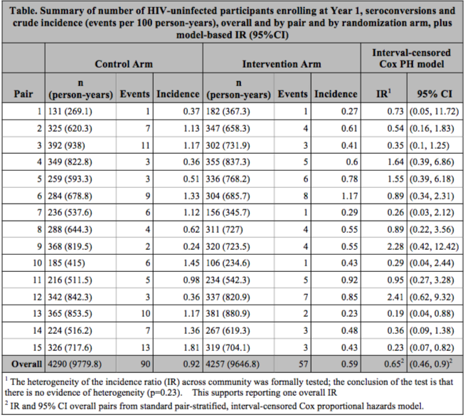

Slide 21
Estimated Survival Curve (95% CI) for Time to HIV Seroconversion by Randomization Arm
(starting 11 months post-enrollment)

